Slide 1
Course : COMP8029 – IT Security and Risk Management
Period : September / February 20XX
Incident Response Reaction, Recovery and Maintenance
Session 10
KDS – Name SME

Slide 2
Objectives
Understand the elements of an incident recovery response, and be aware of the impact of selecting a reaction strategy, developing a notification mechanism, and the creation of escalation guidelines
Know how an organization plans for and executes the recovery process when an incident occurs
Understand the need for and the steps involved in the ongoing maintenance of the incident response plan
Principles of Incident Response and Disaster Recovery

Slide 3
Objectives (continued)
Know what forensic analysis entails, and gain an improved understanding in the processes used to collect and manage data in an electronic environment
Principles of Incident Response and Disaster Recovery

Slide 4
Introduction
A good plan is not enough; the plan must also be executed well to be effective
Incident Response (IR) plan guides the response when an incident occurs, enables recovery of normal operations, and assists in the smooth transition to disaster recovery or business continuity plans when needed
Maintenance of the IR plan should be part of the regular business processes of an organization
Forensic data collection guides the follow-up evaluation
Principles of Incident Response and Disaster Recovery

Slide 5
Reaction
IR strategy determines how and when IR plans are activated
Organization must ensure that the outcome from the planned response meets the organization’s strategic and tactical needs
Principles of Incident Response and Disaster Recovery

Slide 6
Selecting an IR Strategy
When an actual incident is confirmed and classified, the IR team moves into the reaction phase
Factors that influence the IR strategy:
  Do affected systems impact profitable operation?
  Was sensitive or classified information stolen?
  Is the incident contained or is it continuing?
  Is the origin of the emergency internal or external?
  Is the incident public knowledge?
  What are the legal reporting requirements?
  What should be done to identify the attacker?
  When the incident is contained, what are the financial losses?
Principles of Incident Response and Disaster Recovery

Slide 7
Selecting an IR Strategy (continued)
Two general philosophies in response:
  Protect and forget: focus on detection, logging, and analysis of events to recover and prevent recurrence
  Apprehend and prosecute: focus on identifying and apprehending the intruder, preserving potential evidence for prosecution
Although responses to the incident are fundamentally the same, data collection will differ
Principles of Incident Response and Disaster Recovery

Slide 8
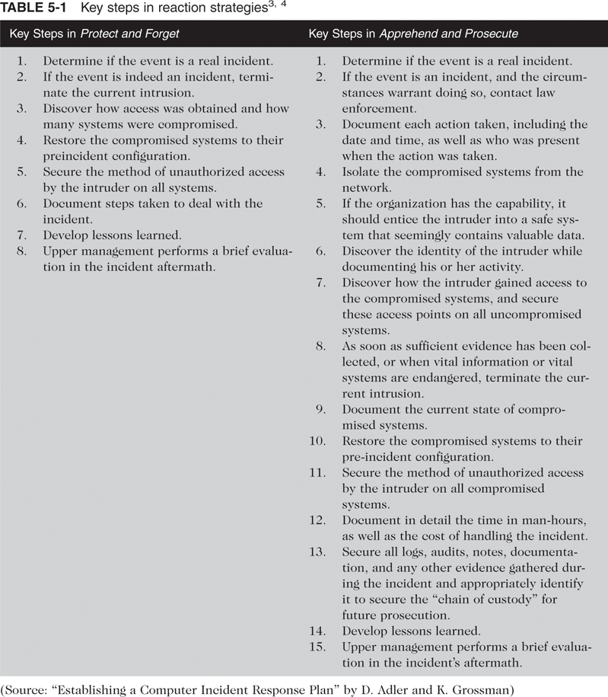
Selecting an IR Strategy (continued)
Principles of Incident Response and Disaster Recovery

Slide 9
Selecting an IR Strategy (continued)
An effective IR plan prioritizes and documents the steps necessary to respond to the event
CERT intrusion response strategies
  Establish policies (procedures) to instructions
  Prepare and train to respond
  Analyze all information to characterize an intrusion
  Communicate with all key personnel
  Collect and protect intrusion information
  Apply short-term solutions to contain the intrusion
  Eliminate all means of intruder access
  Return systems to normal operation
  Identify and implement security lessons learned
Principles of Incident Response and Disaster Recovery

Slide 10
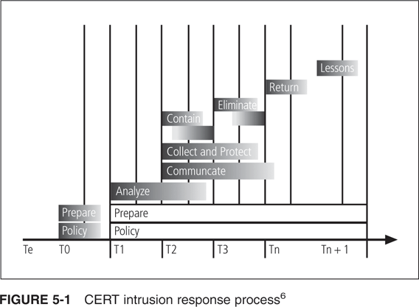
Selecting an IR Strategy (continued)
Principles of Incident Response and Disaster Recovery

Slide 11
Notification
Alert roster: document with contact information for all personnel who must be notified of the event
Two ways to activate an alert roster:
  Sequential roster: a single contact person calls each person on the roster
  Hierarchical roster: first person calls certain others, who in turn call others, and so on
Sequential method preserves accuracy of the message, but hierarchical method is faster
Principles of Incident Response and Disaster Recovery

Slide 12
Notification (continued)
Alert message: a scripted description of the incident containing just enough information that each responder knows what part of the IR plan to implement
Alert roster must be regularly maintained, tested, and rehearsed to remain effective
Other management personnel or business partners may also need to be notified
IR planners must determine in advance whom to notify and when
Principles of Incident Response and Disaster Recovery

Slide 13
Documenting an Incident
Documentation should record the who, when, where, why, and how of each action taken during an incident
Documentation proves the organization did everything possible to contain the incident (due care)
Documentation can also be used for simulation in future training sessions
Principles of Incident Response and Disaster Recovery

Slide 14
Incident Containment Strategies
Must first identify the affected areas to determine what containment actions are to be taken
Containment strategies focus on two tasks:
  Stopping the incident
  Recovering control of the affected systems
For incidents that originate outside the organization, disconnecting the affected communication circuits may be the simplest approach
Profitability areas must be considered before taking extreme actions
Principles of Incident Response and Disaster Recovery

Slide 15
Incident Containment Strategies (continued)
To contain an incident, it may be possible to dynamically apply filtering rules to limit certain types of network access
Other containment strategies include:
  Disabling compromised user accounts
  Reconfiguring a firewall to block the problem traffic
  Temporarily disabling the compromised process or service
  Taking down the conduit application or server
  Stopping all computers and network devices
Principles of Incident Response and Disaster Recovery

Slide 16
Interviewing Individuals Involved in the Incident
Must consider the possibility that the incident was internally caused by personnel in the organization
Interviews involve 3 groups of stakeholders:
  End users
  Help desk personnel
  System administrators
Help staff may be asked to review previous trouble tickets for signs of similar attacks
System administrators may be asked to provide logs and other forensic information
Principles of Incident Response and Disaster Recovery

Slide 17
Incident Escalation
If the incident increases in scope or severity to the point that the IR plan cannot handle it, the incident must be escalated
Business impact analysis should have identified the point at which an incident is deemed a disaster
Incident may be escalated or transferred to an outside authority such as law enforcement
Remember that escalation cannot be undone
Principles of Incident Response and Disaster Recovery

Slide 18
Recovery from Incidents
Incident recovery starts after the incident has been contained and system control has been regained
First task is to inform the necessary personnel
IR team must asses full extent of the damage to determine the recovery efforts that are required
Incident damage assessment:
  Initial determination of the scope of the incident
  May take days or weeks
  May range from minor to severe
Principles of Incident Response and Disaster Recovery

Slide 19
Identify and Resolve Vulnerabilities
Forensics can be used to assess how the incident occurred and what vulnerabilities were exploited
Evidentiary material must be preserved for use in civil or criminal proceedings
Address the safeguards that failed to stop or limit the incident or that were missing; then install, replace, or upgrade them
Evaluate monitoring capabilities to improve detection and reporting methods
Don’t forget fire alarms to detect physical incidents
Principles of Incident Response and Disaster Recovery

Slide 20
Restore Data
IR team must understand the backup strategy used by the organization
Restore data from backups, then use appropriate recovery processes from incremental backups or database journals to recreate data created or modified since the last full backup
Principles of Incident Response and Disaster Recovery

Slide 21
Restore Services and Processes
Compromised services and processes must be examined, verified, and then restored
Continuous monitoring is required to ensure that the incident will not happen again
Principles of Incident Response and Disaster Recovery

Slide 22
Restore Confidence Across the Organization
IR team may issue a memo outlining the incident and assuring all that it is over and the damage was controlled
Memo should be forthright and attempt to reassure users that operations will return to normal as soon as possible
Objective is to prevent panic or confusion from causing additional disruption to operations
Principles of Incident Response and Disaster Recovery

Slide 23
Maintenance
Ongoing maintenance of the IR plan is a major commitment for an organization
Maintenance includes:
  Effective after-action review meetings
  Plan review and maintenance
  Ongoing training of staff involved in incident response
  Rehearsal process to maintain readiness of the IR plan
Principles of Incident Response and Disaster Recovery

Slide 24
The After-Action Review
After-action review (AAR): a detailed examination of events that occurred from detection to recovery
Identify areas of the IR plan that worked, didn’t work, or need improvement
AARs are conducted with all participants in attendance
AAR is recorded for use as a training case
AAR brings the IR team’s actions to a close
Principles of Incident Response and Disaster Recovery

Slide 25
The After-Action Review (continued)
AAR serves several purposes:
  Documents the lessons learned and generates IR plan improvements
  Is a historical record of events, for possible legal proceedings
  Becomes a case training tool
  Provides closure to the incident
Principles of Incident Response and Disaster Recovery

Slide 26
Plan Review and Maintenance
Deficiencies may be found based on AARs or during rehearsals
Periodic reviews are recommended
Useful review questions:
  Has the plan been used since the last review?
  Were any AAR meetings held, and did they identify any deficiencies that need to be addressed?
  Have any other notices of deficiencies been submitted and not yet addressed?
All proposed changes to the IR plan must be coordinated with the CPMT
Principles of Incident Response and Disaster Recovery

Slide 27
Training
Systematic approach to training is required to support the IR plan
A sufficient number of qualified staff members must be cross-trained to ensure coverage
Trained staff must also have the required credentials to be able to execute the actions required by the plan
Principles of Incident Response and Disaster Recovery

Slide 28
Rehearsal
Plans must be rehearsed to ensure that responders are prepared for the actions they are expected to perform
Rehearsals can also pair some staff as understudies to more experienced staff to augment training
Rehearsals can help identify shortcomings
Rehearsals that closely match reality are called war games
War game (or simulation): uses a subset of plans to create a realistic test environment
Principles of Incident Response and Disaster Recovery

Slide 29
Intrusion Forensics
Root cause analysis: determination of the initial flaw or vulnerability that allowed the incident to occur
Computer forensics: the preservation, identification, extraction, documentation, and interpretation of computer media for evidentiary and/or root cause analysis
Treat each investigation as if it will end in legal proceedings to ensure that evidentiary material is not compromised
Principles of Incident Response and Disaster Recovery

Slide 30
Intrusion Forensics (continued)
Evidentiary material: information, graphics, images, or any other physical or electronic item that could have value as evidence of guilt in legal proceedings
Computer forensics has its roots in computer science and criminal justice
Principles of Incident Response and Disaster Recovery

Slide 31
Computer Forensics Methodology
Computer forensics follows a 3-step methodology:
  Collect the evidentiary material
  Analyze the evidentiary material
  Report on the evidentiary material
Must strictly follow established procedures and rigorously document the process and findings
Principles of Incident Response and Disaster Recovery

Slide 32
Collecting Evidentiary Material
Most important part of computer forensics is the identification and collection of evidentiary material without damaging or modifying its content
Motivation behind a search must be considered
Laws governing search and seizure in the private sector require that certain conditions must be met
Law enforcement agents must either have a search warrant or the employer’s consent to search
Principles of Incident Response and Disaster Recovery

Slide 33
Collecting Evidentiary Material (continued)
A private organization can search an employee’s computer if:
  The employee has been notified in policy that such a search may occur
  Search is done for a legitimate business reason
  Search has a specific focus and is constrained to that focus
  Organization has clear ownership over the container of the material
  Search is authorized by the responsible manager or administrator
Principles of Incident Response and Disaster Recovery

Slide 34
Collecting Evidentiary Material (continued)
U.S. Dept. of Justice procedures for search and seizure of computers and electronic evidence:
  Prepare an evidence collection kit: software tools, blank media, digital camera, etc.
  Acquire permission (search warrant) by submitting a statement of intent (affidavit) to an authorized individual
  Secure the scene: separate the suspect from the crime scene to prevent the destruction of evidentiary material
Principles of Incident Response and Disaster Recovery

Slide 35
Collecting Evidentiary Material (continued)
U.S. Dept. of Justice procedures (continued):
  Photograph and sketch the scene
  Identify any potential evidentiary material
  Tag, inventory, and secure the material
  Transport the material to a secure location with limited access, maintaining the chain of custody
  Document everything
Chain of custody (or chain of evidence): log of everyone who had access to or possession of evidentiary material from its collection to its presentation during legal proceedings
Principles of Incident Response and Disaster Recovery

Slide 36
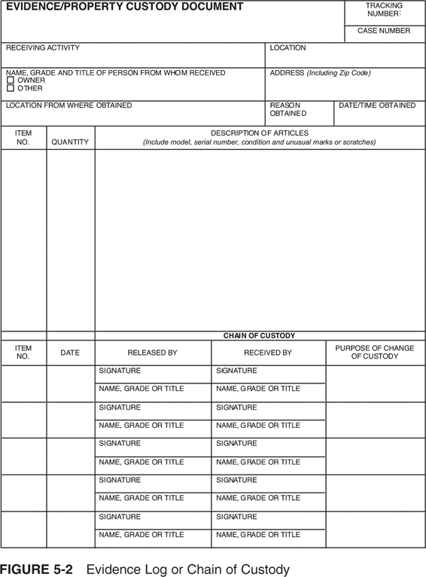
Collecting Evidentiary Material (continued)
Principles of Incident Response and Disaster Recovery

Slide 37
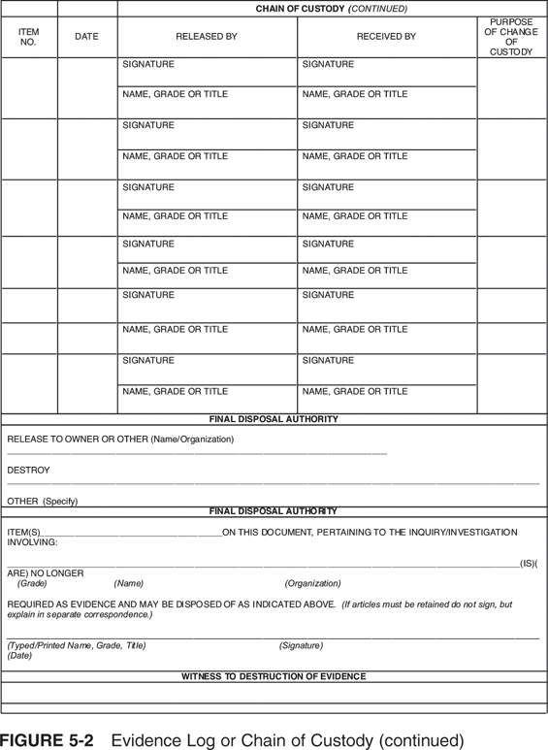
Collecting Evidentiary Material (continued)
Principles of Incident Response and Disaster Recovery

Slide 38
Analyzing the Evidentiary Material
Process of analyzing evidence includes:
  Imaging the data: making a digital copy of the data
  Creating a hash of the evidence to provide authentication
  Creating working backups of the image
  Using an investigative tool to look for evidentiary material in the image
  Documenting everything, including the findings
Hashing: process by which a math algorithm turns a variable-length input into a fixed-length output
Principles of Incident Response and Disaster Recovery

Slide 39
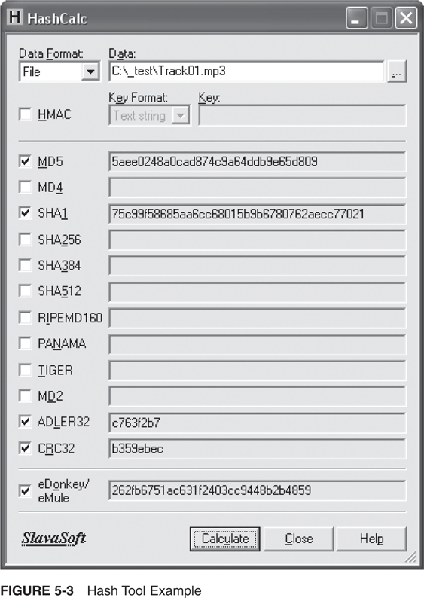
Analyzing the Evidentiary Material (continued)
Principles of Incident Response and Disaster Recovery

Slide 40
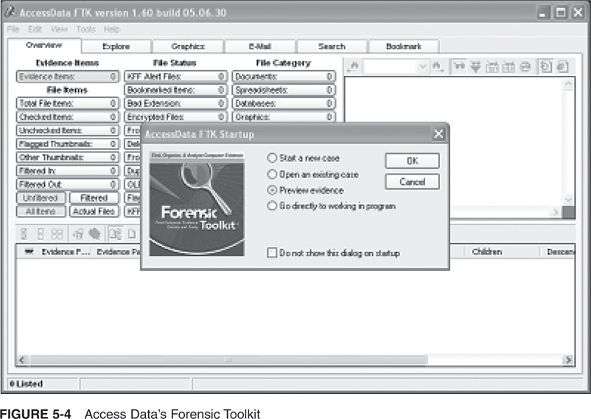
Analyzing the Evidentiary Material (continued)
Principles of Incident Response and Disaster Recovery

Slide 41
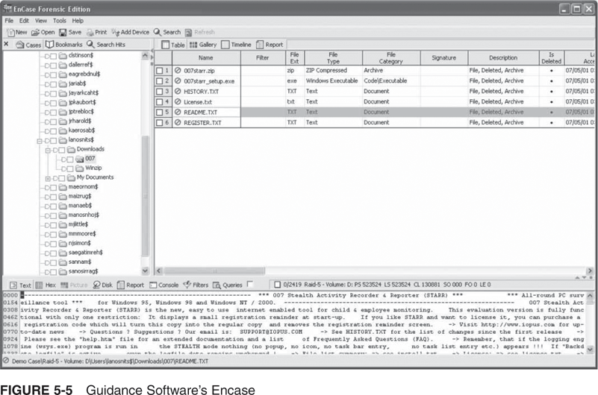
Analyzing the Evidentiary Material (continued)
Principles of Incident Response and Disaster Recovery

Slide 42
Reporting on the Evidentiary Material
A complete report should be filed with the responsible individual (corporate executive or district attorney)
Documentation should include the affidavit, description of the search, materials uncovered during the search, and results of computer forensics examination
Investigator may be called into the legal proceedings to testify
Principles of Incident Response and Disaster Recovery

Slide 43
Managing Evidentiary Data in an Electronic Environment
After the forensics and incident data have been collected, the organization must have plans for how to use that information during and after the incident
Must consider:
  Whether or when to involve law enforcement
  How to keep upper management informed of emerging events
  How to perform loss analysis
Principles of Incident Response and Disaster Recovery

Slide 44
Law Enforcement Involvement
Organization is responsible for notifying law enforcement agencies if civil or criminal law has been violated
Must select the proper law enforcement agency based on the type of crime committed
Advantages of involving law enforcement:
  Better equipped to process evidence
  Prepared to handle warrants and subpoenas
  Adept at obtaining statements from witnesses
Principles of Incident Response and Disaster Recovery

Slide 45
Law Enforcement Involvement (continued)
Disadvantages of involving law enforcement:
  Possible loss of control of the chain of events
  Possible criminal charges against employees
  Removal of key equipment as evidence that may impact the organization’s normal activities
However, if the organization detects a criminal act, it is legally obligated to notify law enforcement
Principles of Incident Response and Disaster Recovery

Slide 46
Reporting to Upper Management
Upper management should first be notified that an incident is in progress after it has been confirmed, but before the media or other external sources learn of it
SIRT leader should report to upper management after the incident has been assessed for its impact on the organization, and the organization’s success or failure in responding has been determined
Principles of Incident Response and Disaster Recovery

Slide 47
Loss Analysis
To determine costs associated with an incident, must consider:
  Cost associated with the number of person-hours diverted from normal operations to react to the incident
  Cost associated with the number of person-hours to recover the data
  Opportunity costs associated with the number of person-hours that individuals could have been working on more productive tasks
  Cost associated with reproducing lost data
  Legal costs associated with prosecuting offenders
Principles of Incident Response and Disaster Recovery

Slide 48
Loss Analysis (continued)
Costs (continued):
  Costs associate with loss of market advantage or share due to disclosure of proprietary information
  Costs associated with acquisition of additional security mechanisms ahead of budget cycle
  Repair or replacement of facilities if an act of nature
  Replacement of computers or other electrical equipment if power incidents
Principles of Incident Response and Disaster Recovery

Slide 49
Summary
IR plan requires significant effort to react and recover from an incident
Two major approaches to IR strategy:
  Protect and forget
  Apprehend and prosecute
When an incident is in progress, notification using an alert message and incident documentation should begin
Main goal of the IR is to stop or contain the scope or impact of the incident
Principles of Incident Response and Disaster Recovery

Slide 50
Summary (continued)
Once the incident has been contained and damage has been assessed, recovery can begin
Ongoing maintenance of the IR plan requires after-action reviews, periodic plan review and maintenance, ongoing staff training, and rehearsal
Principles of Incident Response and Disaster Recovery

